Slide 1
Storage Accounting
John Gordon, Stuart Pullinger
STFC, UK

Slide 2
Background
In 2013 and 2014 we tested storage accounting for a few tests sites using dpm and dcache.
In addition records for all Italian site were cut and sent to APEL by NGI-IT. They harvest the BDII.
The Accounting Portal has a view of this data.
This testing stopped when the test message broker service stopped in 2014.
We now wish to revive this and bring it to production

Slide 3
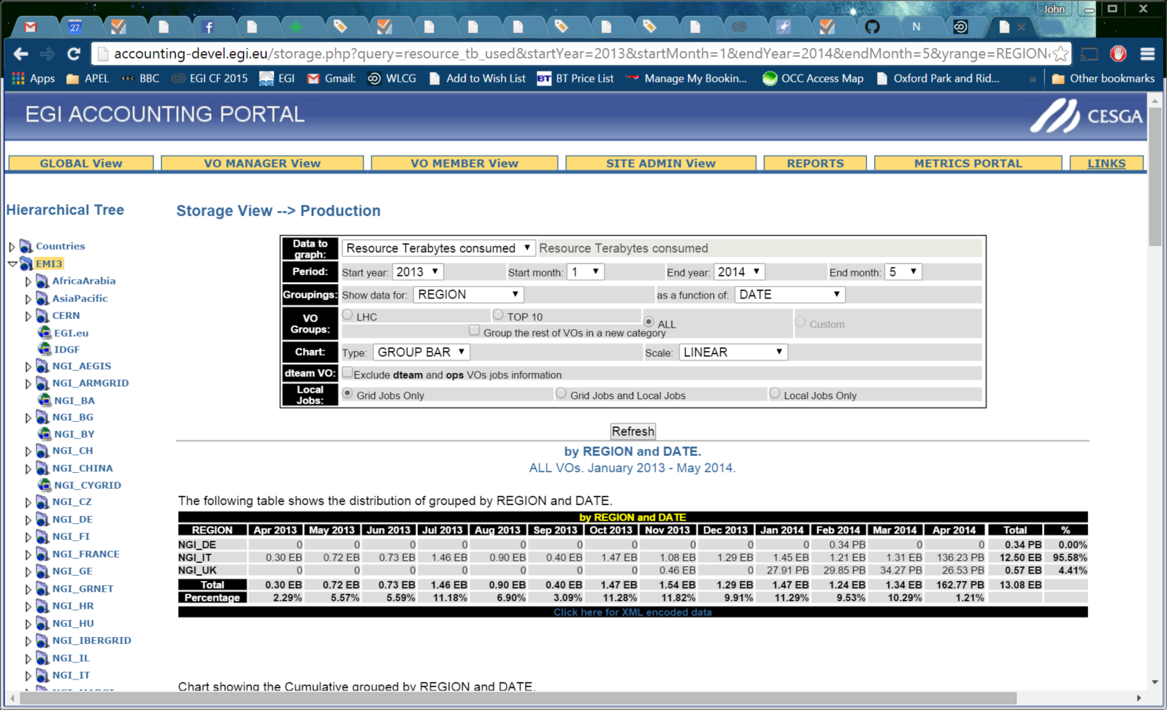
Prototype Portal View

Slide 4
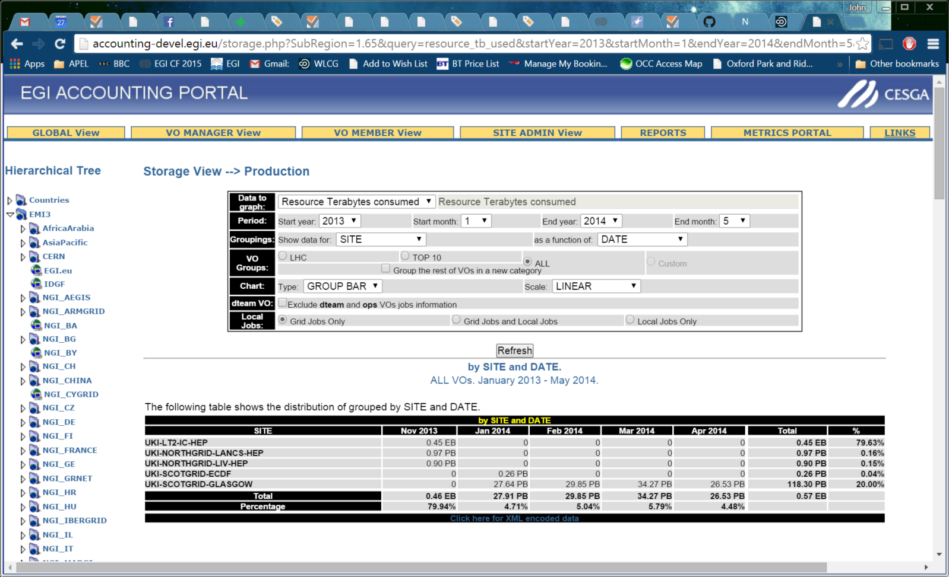
Within an NGI

Slide 5
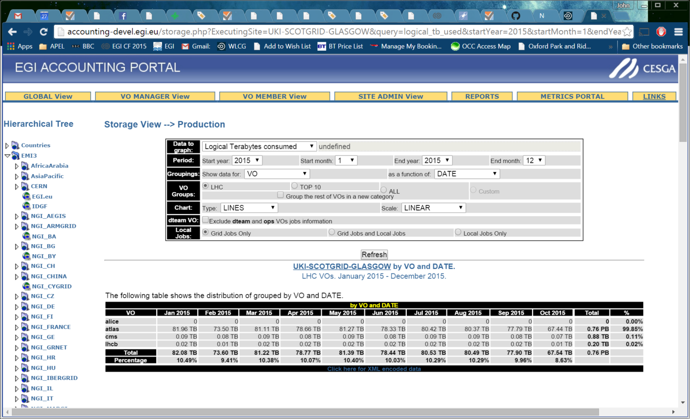
Within a Site

Slide 6
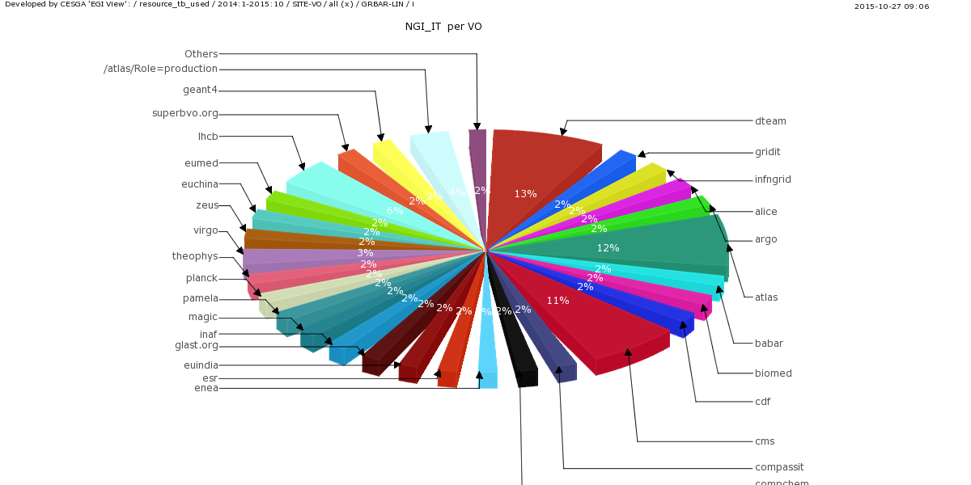

Slide 7
Currrent Status
Three UK dpm and one dcache sites have started publishing
Italy is working on to restart publishing

Slide 8
Current Issues
Revealed by testing
Timestamps:
dcache records have EndTime=CreateTime and StartTime=EndTime - 1 hour
dpm records have StartTime=CreateTime and EndTime=StartTime + 1 month
Italian records have EndTime=CreateTime and StartTime=EndTime - 1 day
dcache doesn’t publish ResourceCapacityAllocated
dpm publishes FQAN instead of VO (or as well as?)
Some Italian Used data looks dubious (ExaBytes)
Portal not processing the totals correctly (to be fixed soon)
No accounting software for other storage systems: xrootd, ceph, StoRM
Notes:
Timestamps not a very big deal. We will be aggregating them into Months anyway. Being the same would prevent unexpected consequences.

Slide 9
Next
We will address the issues with developers
We would like a small number of volunteers to test the documentation https://wiki.egi.eu/wiki/APEL/Storage and starting to publish (now).
starting to publish before bugs are fixed
Comment on prototype portal views http://accounting-devel.egi.eu/storage.php?
Start a campaign to get sites publishing (how soon?)

Slide 11
Cloud Storage
VM with internal storage should cut StAR.
no work done on this yet
VM using traditional storage (dcache) will have the StAR record cut by the server
not a cloud issue
Storage with Cloud interfaces should also cut StAR records at server.
no work done on this yet

